Slide 1


VISVESVARAYA TECHNOLOGICAL UNIVERSITY
"Jnana Sangama", Belagavi: 590 018
Machine Learning -1(BAI602) Mini Project report on
“Email Spam Detection Using Machine Learning”
Submitted in partial fulfilment of the requirement for the award of Degree of
BACHELOR OF ENGINEERING IN
ARTIFICIAL INTELLIGENCE & MACHINE LEARNING
By
Prashant Sanjeev Kamagond 1AY22AI067
DEPARTMENT OF ARTIFICIAL INTELLIGENCE & MACHINE LEARNING
ACHARYA INSTITUTE OF TECHNOLOGY
(Affiliated to Visvesvaraya Technological University, Belagavi)
2024-2025

Slide 2
ACHARYA INSTITUTE OF TECHNOLOGY
(Affiliated to Visvesvaraya Technological University, Belagavi) Soladevanahalli, Bangalore – 560090
DEPARTMENT OF ARTIFICIAL INTELLIGENCE & MACHINE LEARNING
CERTIFICATE
Certified that the Machine Learning-1 (BAI602) mini project entitled Email Spam Detection Using Machine Learning is a bonafide work carried out by Prashant Sanjeev Kamagond (1AY22AI067) of third year B.E degree in partial fulfilment for the award of degree of Bachelor of Engineering in Artificial Intelligence & Machine Learning of the Visvesvaraya Technological University, Belagavi, during the year 2024-2025. It is certified that all corrections/ suggestions indicated for internal assessments have been incorporated in the Report deposited in the departmental library. The mini project report has been approved as it satisfies the academic requirements in respect of project work prescribed for the Bachelor of Engineering Degree.
–––––––––––––––––
Signature of the HOD
Dr. Vijayashekhar S S

Slide 3
DECLARATION
I, Prashant Sanjeev Kamagond (1AY22AI067), students of B.E, Artificial Intelligence and Machine Learning, Acharya Institute of Technology, Bengaluru-107, hereby declare that the Machine Learning-1 (BAI602) mini project entitled " Email Spam Detection Using Machine Learning " is an authentic record of our own. I have not submitted the matter embodied to any other University or Institution for the award of any other degree.
Date: 21/5/2025
Place: Bengaluru
Prashant Sanjeev Kamagond
1AY22AI067

Slide 4
ABSTRACT
With the rapid increase in email communication, spam messages have become a persistent issue, posing security threats and reducing productivity. Traditional rule-based spam filters are often ineffective against evolving spam techniques. This project implements a machine learning-based classification model to automatically detect spam emails. The SMS Spam Collection dataset is used, which contains labeled text messages categorized as "ham" (legitimate) or "spam". The data is preprocessed using text cleaning and vectorized using the TF-IDF (Term Frequency-Inverse Document Frequency) method. A Multinomial Naive Bayes classifier, well-suited for text classification tasks, is then trained on this data. The model achieves high accuracy, precision, and recall, demonstrating its ability to effectively distinguish between spam and non-spam messages. The simplicity and performance of the model make it a practical solution for real-world spam detection systems..
Keywords: Spam Detection, Machine Learning, Text Classification, TF-IDF, Multinomial Naive Bayes, Email Filtering, NLP

Slide 5
TABLE OF CONTENTS
Abstract
i
Chapters | Title | Page No.
1 | Introduction | 6
2 | Problem Statement | 7
3 | Dataset Description | 8
4 | Methodology | 9
5 | Results and Analysis | 10
6 | Conclusion and Future Work | 12
7 | References | 13
 | A. Sample Code | 14
 | B. Screenshots | 17

Slide 6
Email Spam Detection Using Machine Learning
INTRODUCTION
This project, titled "Email Spam Detection Using Machine Learning", focuses on building an intelligent system to automatically classify email or SMS messages as either spam or ham (legitimate). Email has become an essential mode of communication for both personal and professional use. However, the increasing reliance on email has led to a surge in unsolicited messages, commonly known as spam. Spam emails can range from unwanted advertisements to dangerous phishing attacks that attempt to steal personal information or install malware.
Traditional rule-based spam filters often struggle to keep up with the dynamic nature of spam content, as attackers frequently modify their strategies to bypass filters. As a result, there is a growing need for intelligent and adaptive methods to identify and filter spam effectively.
In this project, a machine learning-based classification model is developed to detect spam messages automatically. The model is trained using the SMS Spam Collection dataset, a widely used dataset containing labeled text messages. To convert the textual content into numerical form, the TF-IDF (Term Frequency-Inverse Document Frequency) vectorization technique is used, which highlights the most significant words in each message.
The classification is performed using the Multinomial Naive Bayes algorithm, which is particularly effective for text data and commonly used in spam detection tasks. The model is evaluated using performance metrics such as accuracy, precision, recall, and F1-score. The results show that the model performs well in identifying spam messages while minimizing false positives.
Overall, this project demonstrates how machine learning techniques can be applied to real-world problems like spam detection. The proposed model is not only efficient but also scalable, making it suitable for integration into various digital communication systems. With continued training and updates, it has the potential to significantly reduce the impact of spam on users and organizations.

Slide 7
Email Spam Detection Using Machine Learning
PROBLEM STATEMENT
In today’s digital era, email is one of the most widely used communication tools for both personal and professional purposes. However, the convenience of email comes with significant challenges, the most pressing of which is the proliferation of unsolicited and unwanted emails, commonly known as spam. Spam emails not only clutter inboxes but can also carry malicious content such as phishing attempts, malware, and fraudulent schemes. These pose serious threats to users’ privacy, security, and productivity.
Traditional spam filtering techniques, often rule-based or keyword-based, are increasingly ineffective due to the evolving tactics used by spammers. These conventional filters rely on static rules, blacklists, or simple heuristics, which are easily circumvented by sophisticated spammers who continuously alter message content and structure to bypass detection. As a result, many spam messages still reach user inboxes, and some legitimate emails are incorrectly marked as spam, leading to communication breakdowns.
The problem, therefore, is to develop a robust, adaptive, and accurate method for spam email detection that can automatically classify incoming messages as spam or legitimate (ham). Such a system should effectively identify spam emails based on their content without relying solely on hard-coded rules. This requires a solution capable of learning from historical data and generalizing well to new, unseen messages.
This project aims to address this challenge by implementing a machine learning-based classification model that analyzes email or SMS text content to predict whether a message is spam. Using the SMS Spam Collection dataset, the project will preprocess the data, extract meaningful features using the TF-IDF vectorization technique, and train a Multinomial Naive Bayes classifier to distinguish spam from legitimate messages. The model will be evaluated using metrics such as accuracy, precision, recall, and F1-score to ensure it performs reliably.

Slide 8
Email Spam Detection Using Machine Learning
DATASET DESCRIPTION
For this project, the SMS Spam Collection Dataset is used, which is a widely recognized dataset for spam detection tasks. The dataset contains a collection of SMS messages labeled as either “spam” or “ham” (legitimate), enabling supervised machine learning models to distinguish between unwanted and genuine messages.
The dataset includes approximately 5,574 SMS messages, with around 747 labeled as spam and 4,827 as ham. This distribution reflects real-world scenarios, where spam messages are less frequent but still pose significant risks.
Each entry consists of two main columns:
Label: Denotes if the message is spam or ham
Message: The actual text content of the SMS
The messages vary widely in length and style, from casual conversations to promotional or phishing attempts. This variety helps the model generalize and effectively identify diverse spam patterns.
Data Preprocessing and Feature Extraction
Before training, the dataset undergoes preprocessing steps such as cleaning the text, removing unnecessary characters, and transforming the text into numerical features using TF-IDF (Term Frequency-Inverse Document Frequency). This technique assigns importance to words based on how frequently they appear in a message compared to across all messages, helping the model focus on meaningful words for classification.
Dataset Visualization (Example)
Including a bar chart or pie chart showing the distribution of spam versus ham messages in the dataset would be helpful for visual understanding. This can clearly show the class imbalance and provide insight into the dataset's structure.
Kaggle Dataset : https://www.kaggle.com/uciml/sms-spam-collection-dataset
Label | Description
spam | Unsolicited promotional or malicious messages
ham | Legitimate, non-spam messages

Slide 9
Email Spam Detection Using Machine Learning
METHODOLOGY
a) Data Collection:
The project uses the publicly available SMS Spam Collection Dataset. This dataset contains thousands of SMS messages labeled as either spam or ham, providing a rich source of data for training and testing the model.
b) Data Preprocessing:
Text Cleaning: Removing punctuation, converting all text to lowercase, and eliminating irrelevant characters.
Tokenization: Breaking down messages into individual words or tokens.
Stop Words Removal: Commonly used words that do not contribute much meaning (like "and", "the") are removed.
Feature Extraction using TF-IDF: The cleaned text is converted into numerical vectors using Term Frequency-Inverse Document Frequency (TF-IDF), which highlights the importance of words within a message relative to the entire dataset
c) Model Selection and Training:
The project uses the Multinomial Naive Bayes classifier, which is well-suited for text classification problems. This algorithm assumes that the features (words) are conditionally independent given the class label, making it efficient for high-dimensional data like text.
The model is trained on the preprocessed dataset, learning patterns and relationships between words and their associated labels (spam or ham).
d) Model Evaluation:
Accuracy: The percentage of correctly classified messages.
Precision: The ability of the model to correctly identify spam messages without misclassifying ham.
Recall: The model’s ability to detect all actual spam messages.
F1-Score: The harmonic mean of precision and recall, providing a balanced measure of the model’s performance.
e) Prediction on New Messages:
Once validated, the model is used to predict whether new, unseen messages are spam or ham. This demonstrates the practical application of the model in real-world scenarios.

Slide 10
Email Spam Detection Using Machine Learning
RESULTS AND ANALYSIS
The trained Multinomial Naive Bayes model was evaluated using a test dataset, and its performance was measured using key classification metrics. The results indicate that the model performs exceptionally well in distinguishing between spam and ham messages
Evaluation Metrics:
Accuracy : 98.38%
This indicates that the model correctly classified 98.38% of all messages in the test set.
Confusion Matrix
True Positives (Spam correctly identified): 134
True Negatives (Ham correctly identified): 963
False Positives (Ham misclassified as spam): 2
False Negatives (Spam misclassified as ham): 16
Classification Report
The model demonstrates strong performance, especially in accurately identifying legitimate (ham) messages, which is critical in avoiding message loss for users.
Multinomial Naive Bayes, known for its simplicity and effectiveness in text classification, performed well and required minimal computational resources.:
The use of TF-IDF for feature extraction played a crucial role in emphasizing relevant words, improving model effectiveness.
:
 | Predicted Ham | Predicted Spam
Actual Ham | 963 | 2
Actual Spam | 16 | 134
Class | Precision | Recall | F1-Score
Ham (0) | 0.98 | 1.00 | 0.99
Spam (1) | 0.99 | 0.89 | 0.94

Slide 11
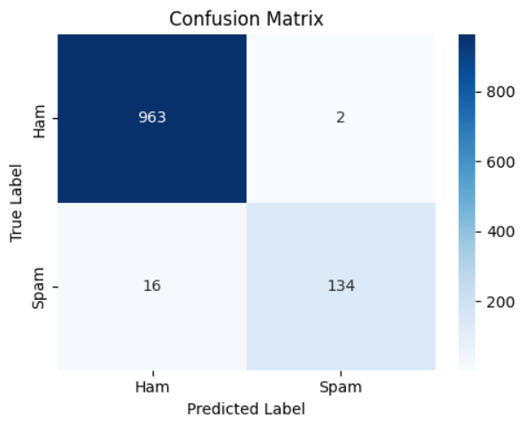
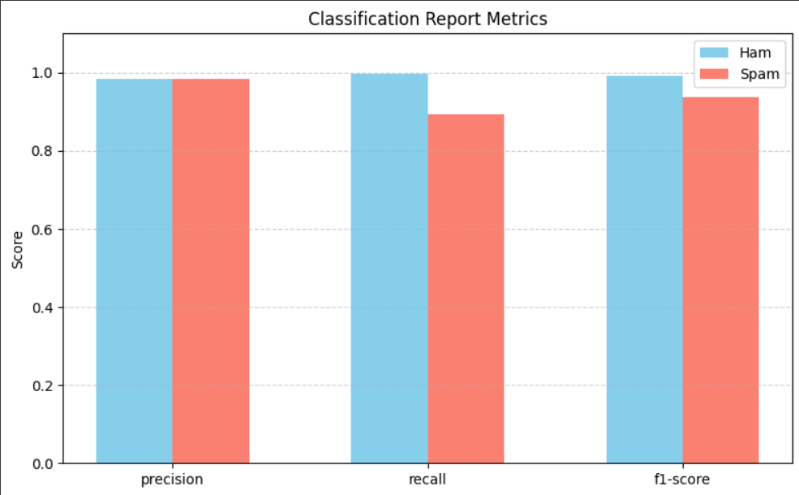

Slide 12
Email Spam Detection Using Machine Learning
CONCLUSION AND FUTURE WORK
Conclusion
This project, titled "Email Spam Detection Using Machine Learning", successfully demonstrates the application of supervised classification techniques to identify spam messages in SMS communication. By leveraging the Multinomial Naive Bayes classifier and TF-IDF vectorization, the model achieved a high accuracy of 98.38%, effectively distinguishing between spam and legitimate messages (ham). The results indicate that machine learning models, when trained on quality labeled data, can significantly enhance the efficiency of spam filtering systems with minimal false positives and negatives.
The performance metrics including precision, recall, and F1-score further validate the reliability of the approach. The model is lightweight, interpretable, and suitable for real-time deployment in messaging platforms and email services.
Future Work
In the future, this project can be extended by exploring more sophisticated machine learning algorithms such as Random Forest, Support Vector Machines (SVM), or deep learning models to enhance the detection capabilities and accuracy. Additionally, using a larger and more diverse dataset, possibly including multilingual data, could improve the model’s robustness across different languages and spam styles. Incorporating advanced Natural Language Processing (NLP) techniques like BERT or LSTM could allow the system to better understand the contextual meaning of messages, which is particularly useful for detecting more subtle or disguised spam. Further, deploying the model in real-time environments such as email servers or messaging apps could provide immediate protection to users. Lastly, implementing a user feedback mechanism, where the model learns from user-marked spam or ham messages, could enable continuous learning and adaptability to evolving spam tactics.

Slide 13
Email Spam Detection Using Machine Learning
REFERENCES
Almeida, T. A., Hidalgo, J. M. G., & Yamakami, A. (2011). Contributions to the study of SMS spam filtering: new collection and results. Proceedings of the 11th ACM symposium on Document engineering, 259–262. https://www.aclweb.org/anthology/W11-0304.pdf
SMS Spam Collection Dataset – UCI Machine Learning Repository: https://archive.ics.uci.edu/ml/datasets/sms+spam+collection
Pedregosa, F., Varoquaux, G., Gramfort, A., et al. (2011). Scikit-learn: Machine Learning in Python. Journal of Machine Learning Research, 12, 2825–2830.
TF-IDF Explained. (n.d.). Towards Data Science. https://towardsdatascience.com/tf-idf-explained-using-python-example-5b2b2f115b48
Naive Bayes Classifier. (n.d.). Geeks for Geeks. https://www.geeksforgeeks.org/naive-bayes-classifiers/

Slide 14
Email Spam Detection Using Machine Learning
APPENDICES
A.SAMPLE CODE
import pandas as pd
import numpy as np
from sklearn.model_selection import train_test_split
from sklearn.feature_extraction.text import TfidfVectorizer
from sklearn.naive_bayes import MultinomialNB
from sklearn.metrics import (
accuracy_score, classification_report,
confusion_matrix, precision_score,
recall_score, f1_score
)
import matplotlib.pyplot as plt
import seaborn as sns
import joblib
# Step 1: Load Data
path = '/content/spam.csv'
df = pd.read_csv(path, encoding='latin-1')
df = df[['v1', 'v2']]
df.columns = ['label', 'message’]
# Step 2: Data Preprocessing
df['label'] = df['label'].map({'ham': 0, 'spam': 1})
X = df['message’]
y = df['label']

Slide 15
vectorizer = TfidfVectorizer()
X_vectorized = vectorizer.fit_transform(X)
#Step 3: Train-Test Split
X_train, X_test, y_train, y_test = train_test_split(
X_vectorized, y, test_size=0.2, random_state=42
)
#Step 4: Model Training
model = MultinomialNB()
model.fit(X_train, y_train)
#Step 5: Model Evaluation
y_pred = model.predict(X_test)
# Accuracy
acc = accuracy_score(y_test, y_pred)
print("Accuracy:", acc)
# Classification Report
print("\nClassification Report:\n", classification_report(y_test, y_pred))
# Confusion Matrix
conf_matrix = confusion_matrix(y_test, y_pred)
sns.heatmap(conf_matrix, annot=True, fmt='d', cmap='Blues')
plt.title("Confusion Matrix")
plt.xlabel("Predicted")
plt.ylabel("Actual")
plt.show()
#Step 6: Save Model for Deployment
joblib.dump(model, 'spam_classifier_model.pkl')
joblib.dump(vectorizer, 'tfidf_vectorizer.pkl')

Slide 16
Email Spam Detection Using Machine Learning
#Step 7: Predict on Custom Messages
custom_messages = [
"Congratulations! You've won a free ticket. Call now!",
"Hey, are we still meeting today?",
"URGENT! Your account will be closed unless you update your payment."
]
custom_vec = vectorizer.transform(custom_messages)
custom_pred = model.predict(custom_vec)
for msg, pred in zip(custom_messages, custom_pred):
label = 'Spam' if pred == 1 else 'Ham'
print(f"Message: {msg}\nPrediction: {label}\n")

Slide 17
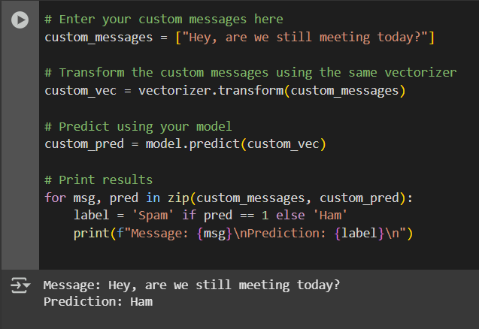
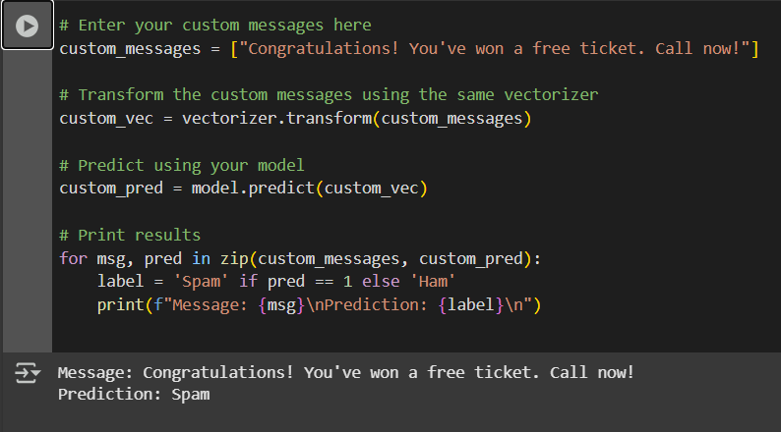
Email Spam Detection Using Machine Learning
Prediction Result as a Ham
Prediction Result as a Spam

Slide 18
